Slide 1
Introduction to Django & MVT

Slide 2
MVT: Model, View, Template.
Model → Python classes representing database tables (ORM).
View → Functions handling web requests and responses. Django replaces the traditional MVC “Controller” with the View.
Template → HTML files with placeholders to display data.

Slide 3
Django Philosophy: Batteries-Included
High-level Python web framework for rapid development
Provides ORM, admin, auth, forms, templates, sessions out of the box
Focus on reusing components instead of reinventing the wheel
Secure, scalable and follows "don’t repeat yourself" (DRY)

Slide 4
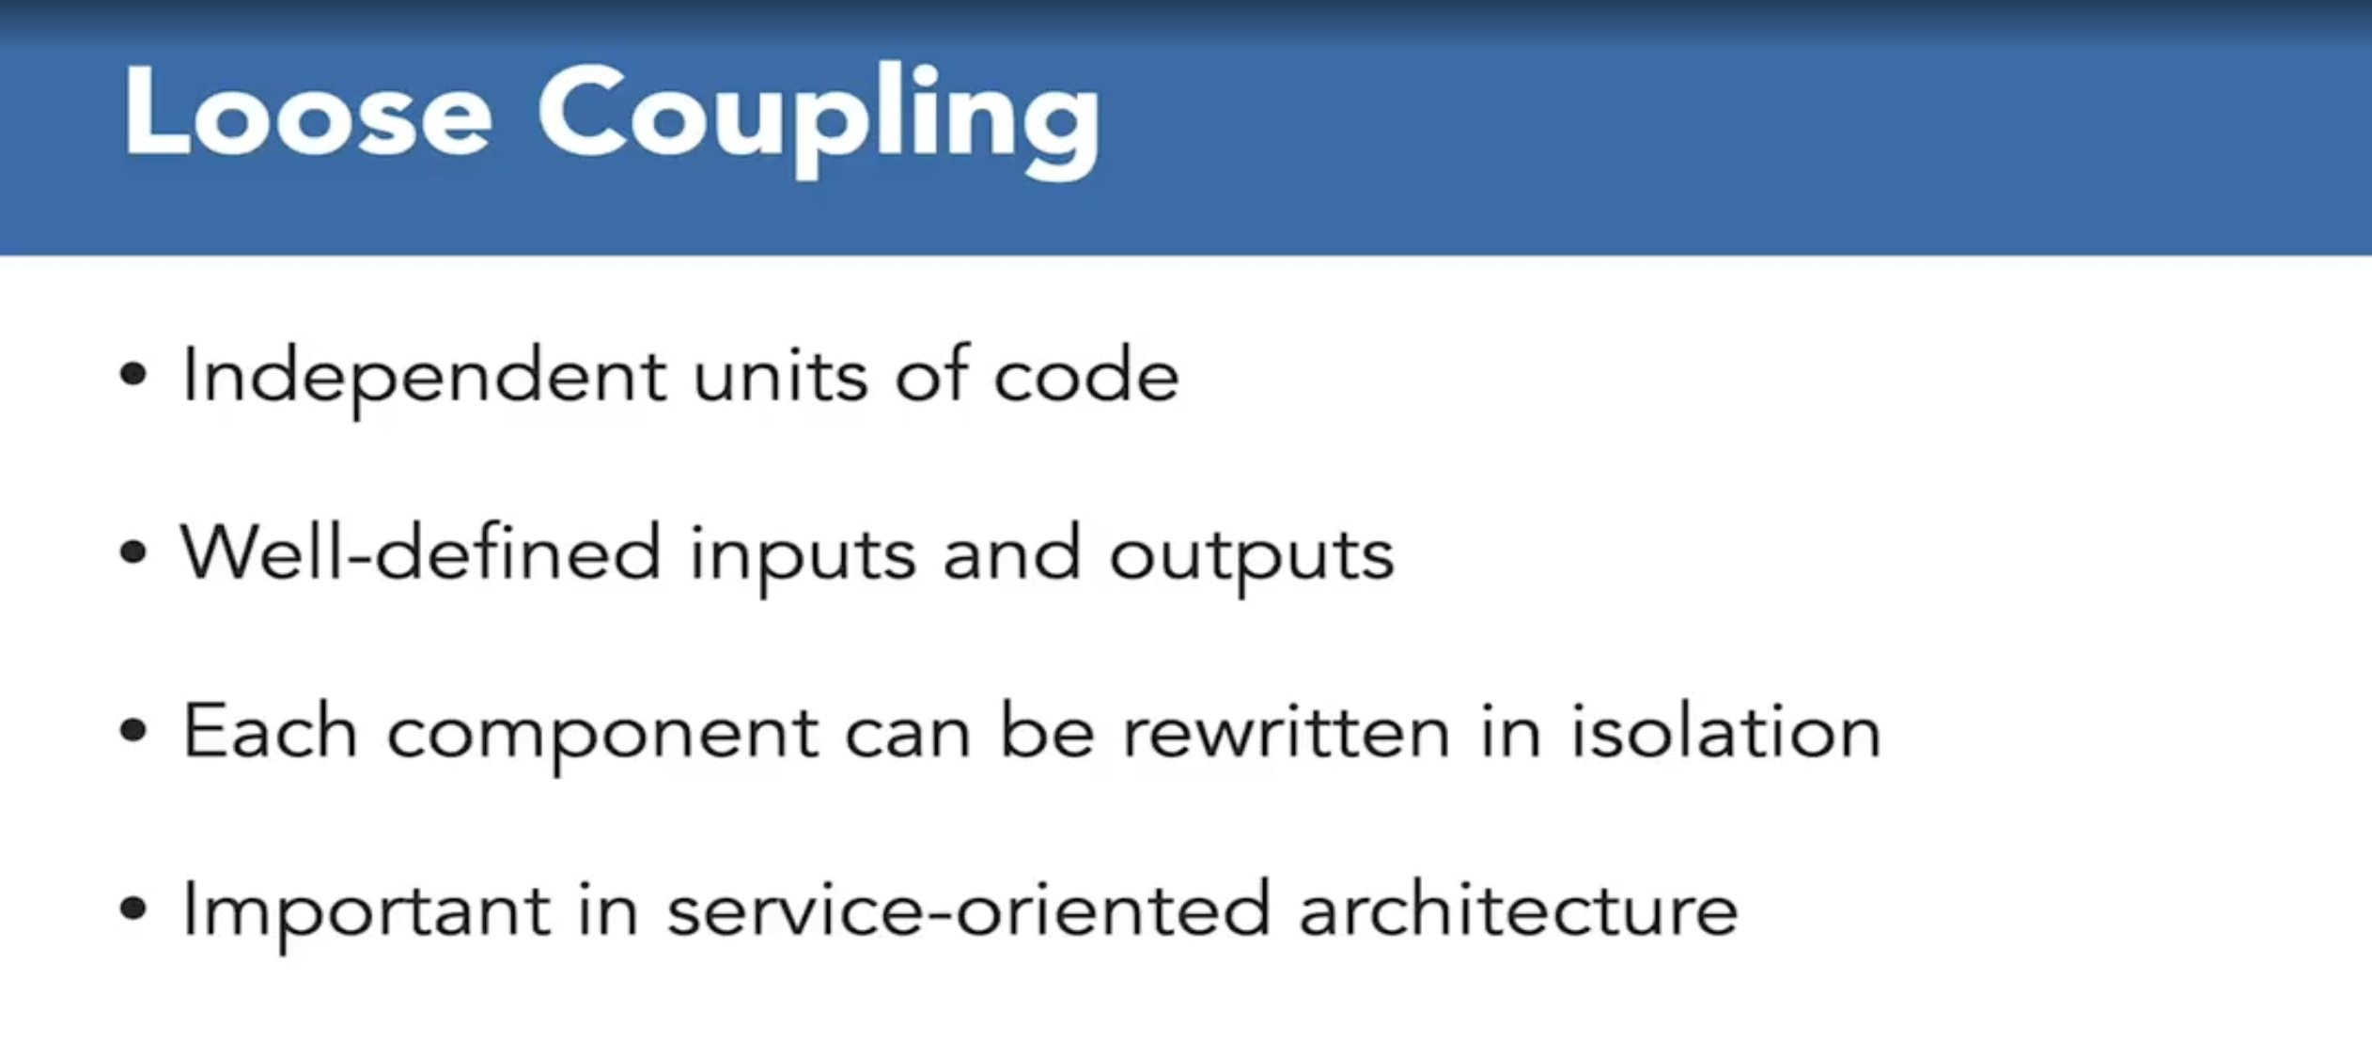

Slide 5
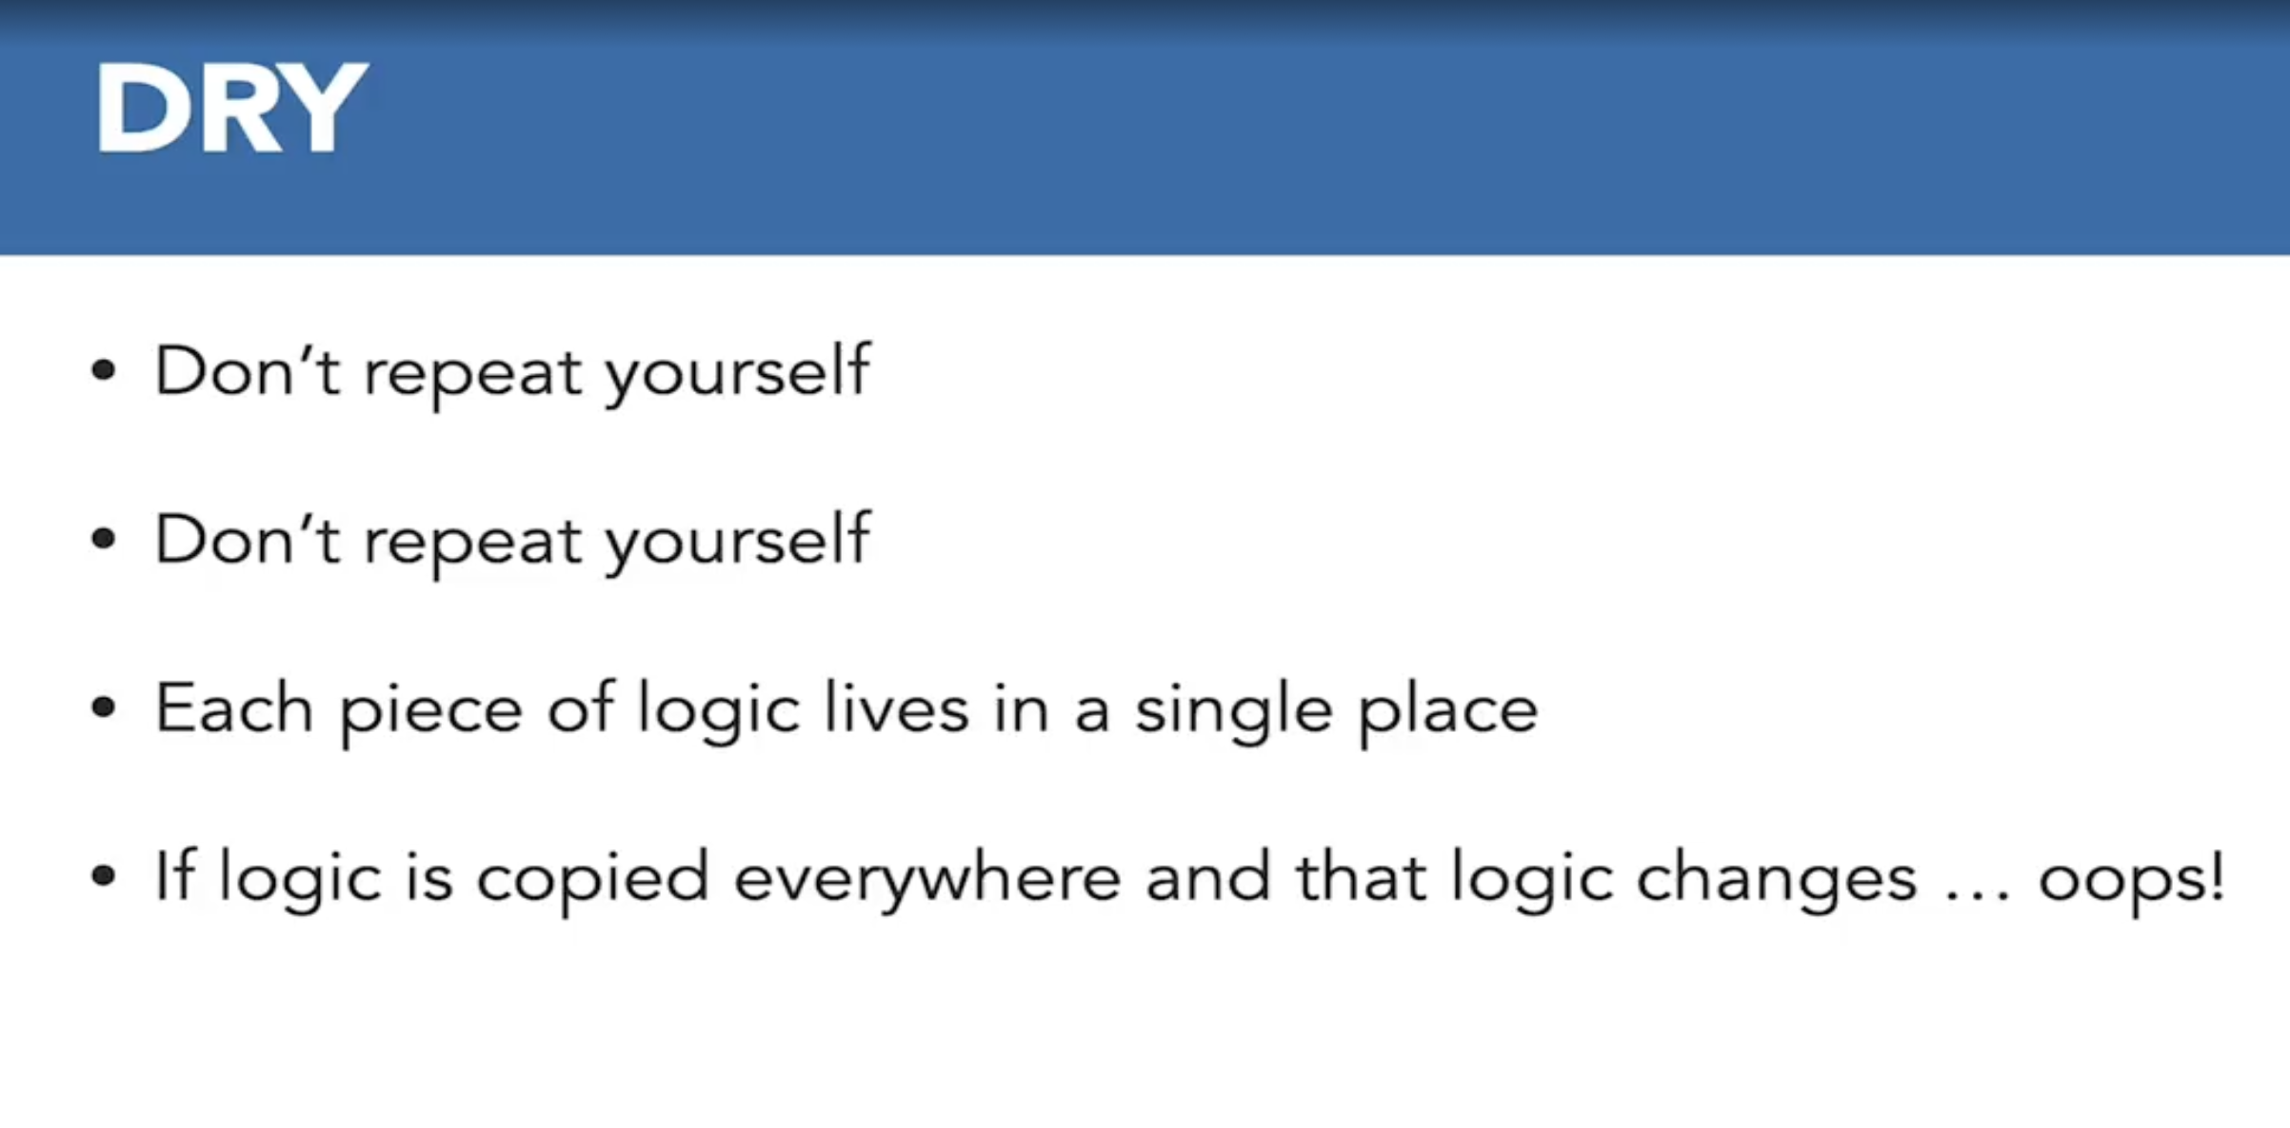

Slide 6
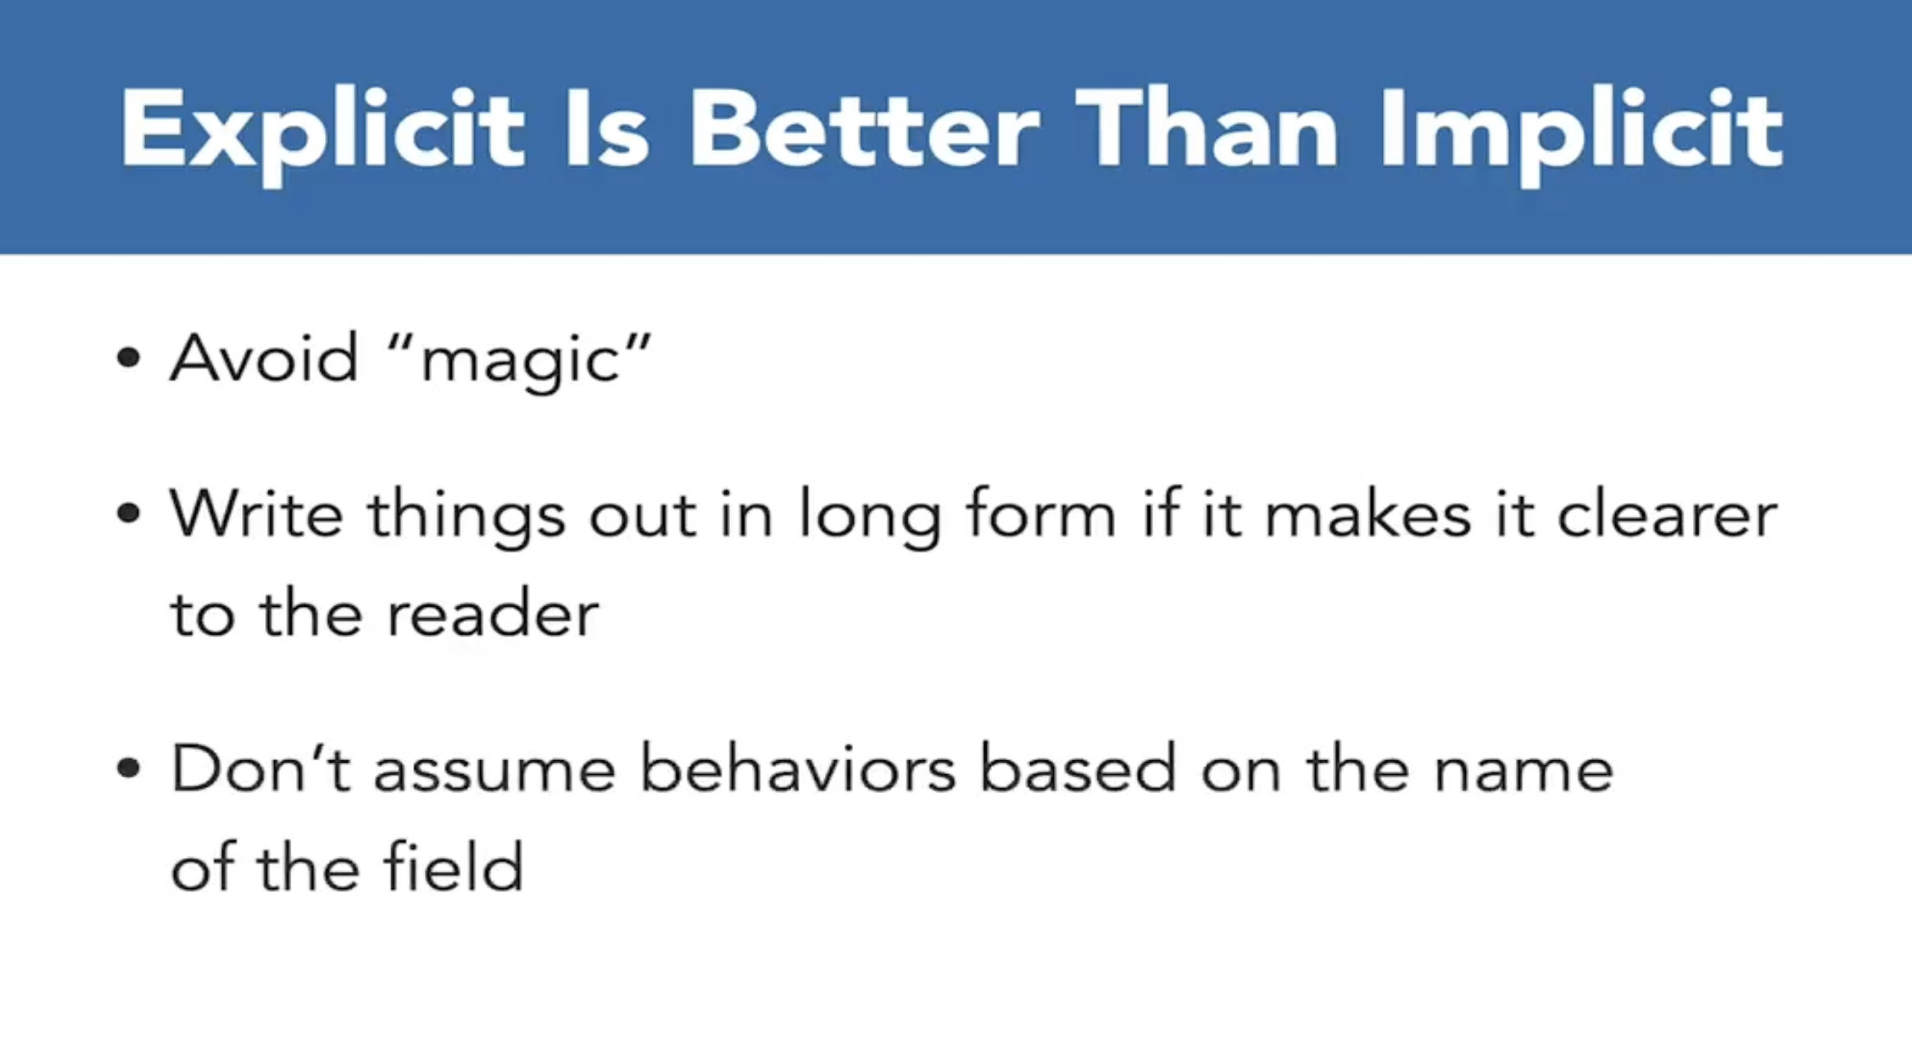

Slide 7
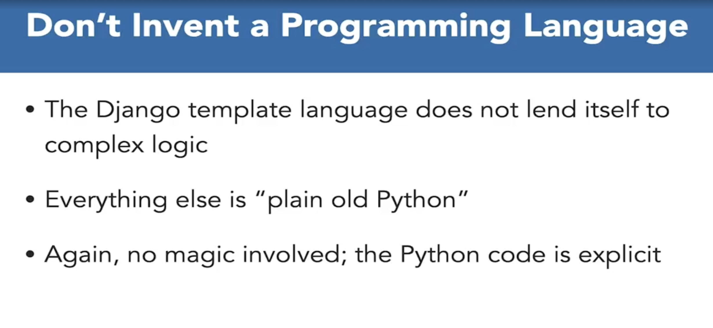

Slide 8
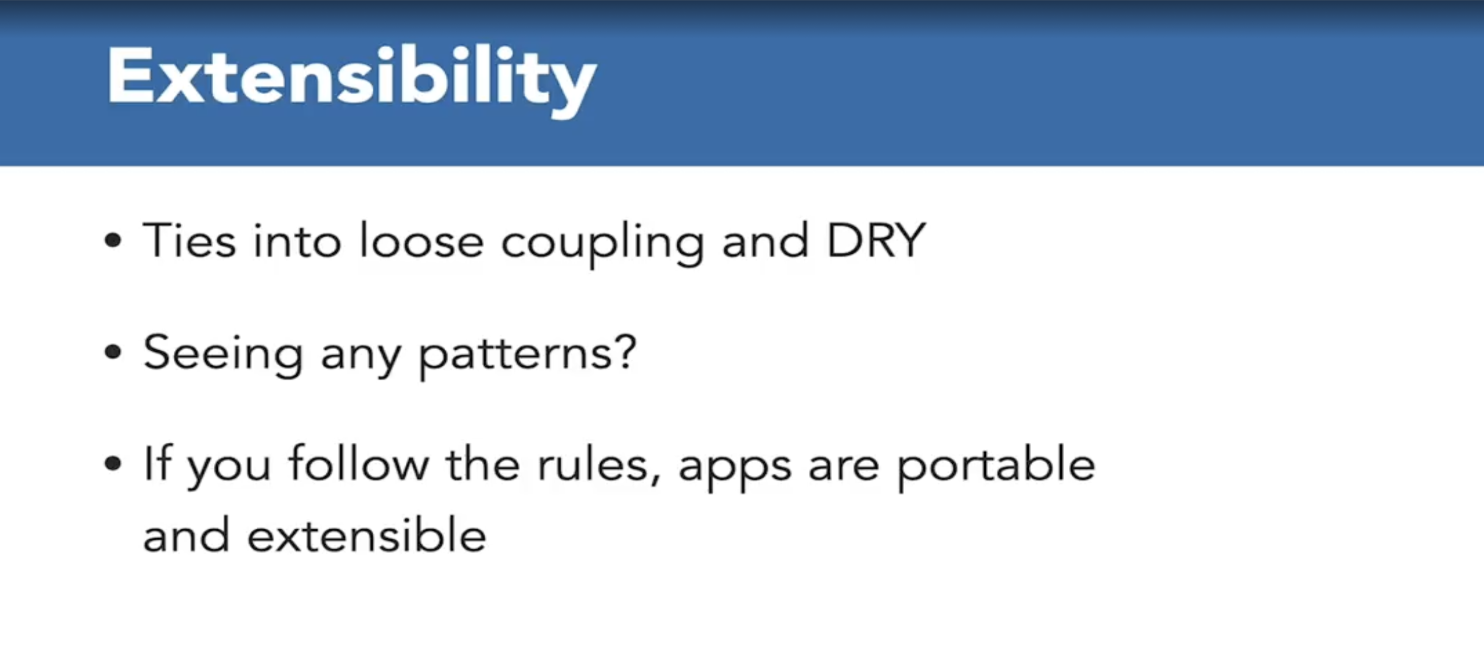

Slide 9
How Django structures a web app?
Model – View – Template
Model
(Database / ORM)
View
(Business logic)
Template
(HTML output)

Slide 10
Request–Response Flow in Django
From browser to database and back.
Browser
URLconf
View
Model / DB
Template
HTTP Response

Slide 11
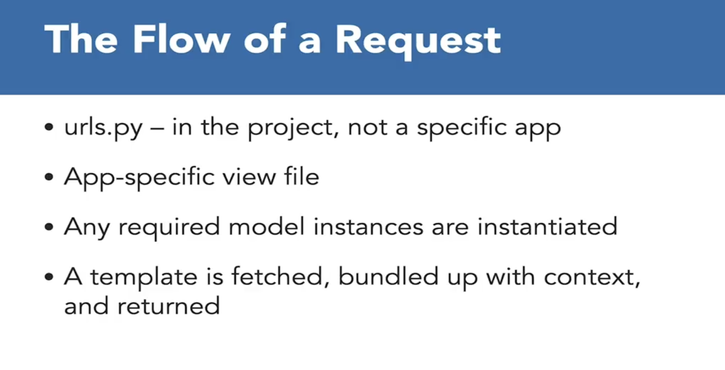

Slide 12
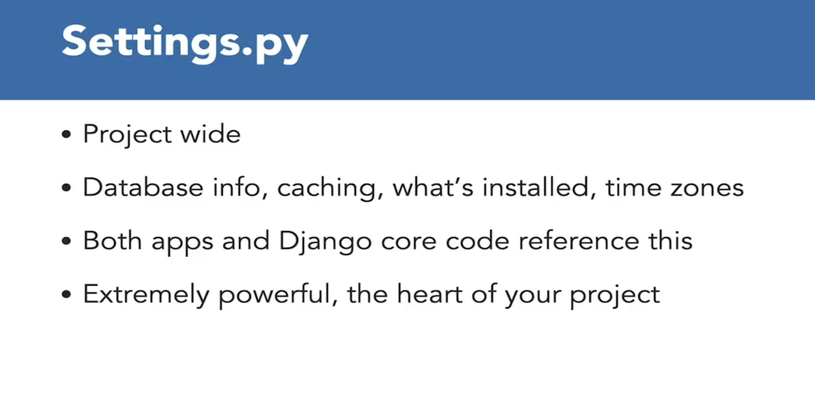

Slide 13
Environment Setup Essentials
Create a virtual environment: python -m venv venv
1
Activate venv and install Django: pip install django
2
Use pip freeze > requirements.txt to record dependencies
3
Keep project isolated so different projects can use different versions
4

Slide 14
Project & App Scaffolding
django-admin startproject mysite
python manage.py startapp cheese
Project = settings + configuration for the whole site
App = a reusable module (blog, polls, shop, etc.)

Slide 15
Models, Migrations & Admin
Define models as Python classes (ORM maps them to DB tables)
1
Create migrations: python manage.py makemigrations
2
Apply migrations: python manage.py migrate
3
Register models in admin.py to get automatic CRUD UI
4

Slide 16
Key Concepts to Remember
MVT: Model (data), View (logic), Template (presentation)
Batteries-included: many features built-in and ready to use
pip + virtualenv: manage and isolate project dependencies
Scaffolding & commands: startproject, startapp, migrate, runserver

